Slide 1
Retention Focus in COP18 and COP19 – Update for Siyenza Leads

Slide 2
Retention on Treatment is one of the Major Challenges to Achieving 90-90-90 in S. Africa with 74% 12-month Retention Reported at APR18
Notes:
During her visit Ambassador Birx noted the need to really be targeting our retention interventions by population and district. We still have a ways to go before we can tell you the reason why different populations fair worse in different districts, however, we have tried to look at the data in a more disaggregated way.
Key take-aways from looking at the data this way are:
Overall retention is quite high in Amathole, which is one of our districts with the lowest performance in case finding, but highest performance in linkage & retention. Also district that has allowed partner to really staff this cadre directly
Retention among children and adolescents is quite Gauteng – CoJ, Ekurhuleni, Tshwane all have retention rates at <50% in older boys and/or adolescent men and women. These are places where we need to most heavily invest in our adolescent interventions
Limpopo conversely has very low retention in older populations, and may be a place where further investigating access issues and stigma would be key.

Slide 3
Aggressive Site Support via FF and Siyenza led to Substantial Improvements in Net_New and Net New/TX_NEW in Q2 of FY19
Overall TX_NET_NEW is higher than it has been for the past four quarters.
South Africa surpassed 200,000 TX_NET_NEW in one quarter, a first for the program.
TX_NET_NEW results are higher than TX_NEW signalling improvement in retention and return of patients to care.

Slide 4
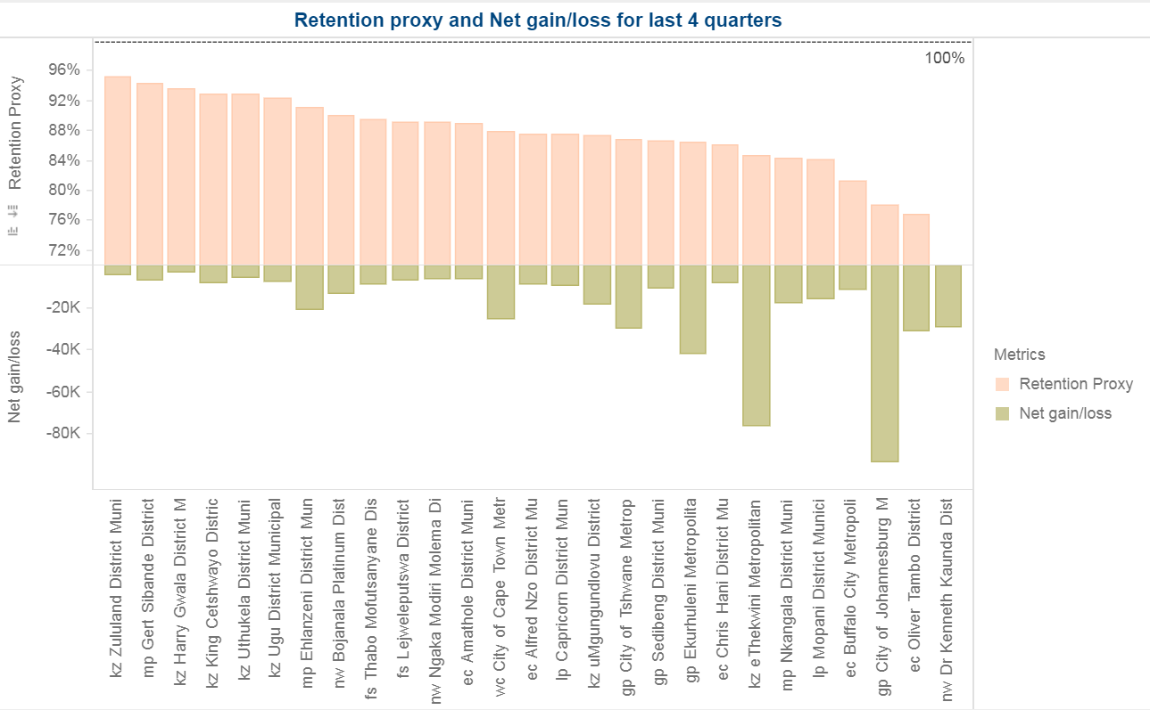
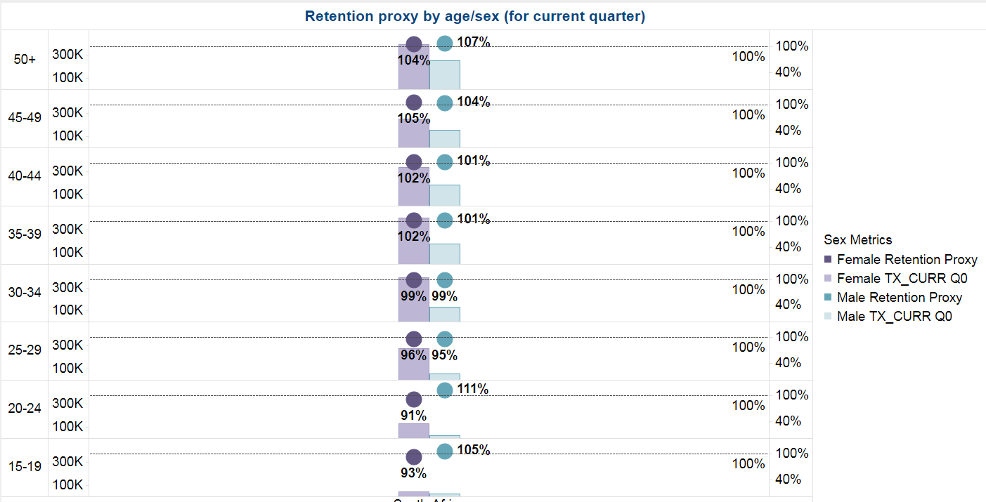
Latest Retention Data Appears to Show Improvements as well
Retention Proxy in the 27 districts for the last 4 quarters was 86%, ranging from 70% to 95%;
In FY19 Q2 the retention proxy exceeded 90% across all adult age/sex disaggregations
Retention proxy formula = 1+ (TX_NET_NEW – TX_NEW)/(TX_CURR – TX_NET_NEW + TX_NEW)
Numbers likely boosted by those already on treatment >12 months (which generally have higher treatment) as well as Net New Gains from data cleaning and return to care in FY19 Q2

Slide 5
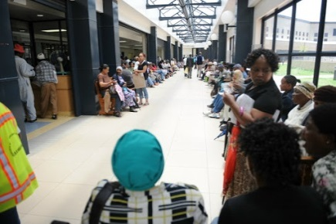



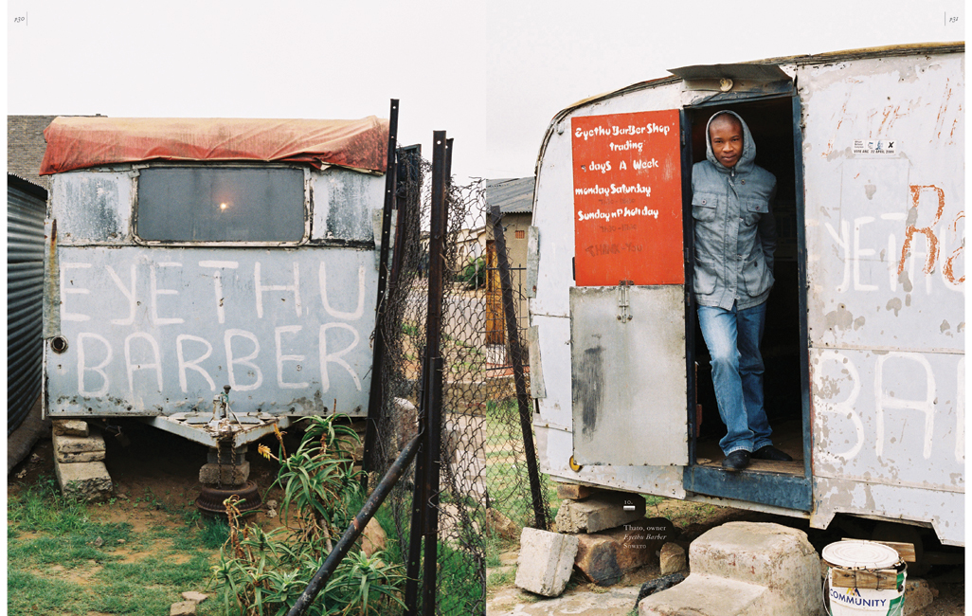

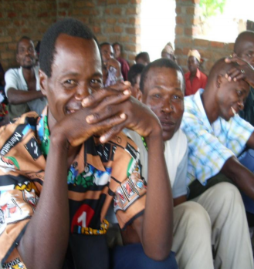

PEPFAR Program is Continuously Reviewing Where and Why We are Losing Patients and Interventions to Address these Challenges
Community-Based ART Initiation and Management limited to Public Mobile Clinics
Facility in-take processes confusing
Mobile Clinic
Hospital/
PHC/CHC
SFLA
6 Months
12 months
Positive Client
Health Worker
Adherence Clubs
Limited support networks and economic opportunities
Believe facilities as unfamiliar, judgmental, feminine spaces
Newly positives face “shock” and “denial”
Limited time and motivation to follow protocols
Limited capacity to reach patients where they are
Inadequate counseling/ patient education
Feel “better”
Adverse drug effects
Treatment fatigue
Mobile population
Not all stable patients decanted, contributing to over-burdened facilities and long waits
Treatment fatigue
Pick-up Points
CCMDD
Ideal patient pathway
Drop-off
Data flow to confirm ART pick-ups
Viremia
Dissatisfied with decanted option

Slide 6
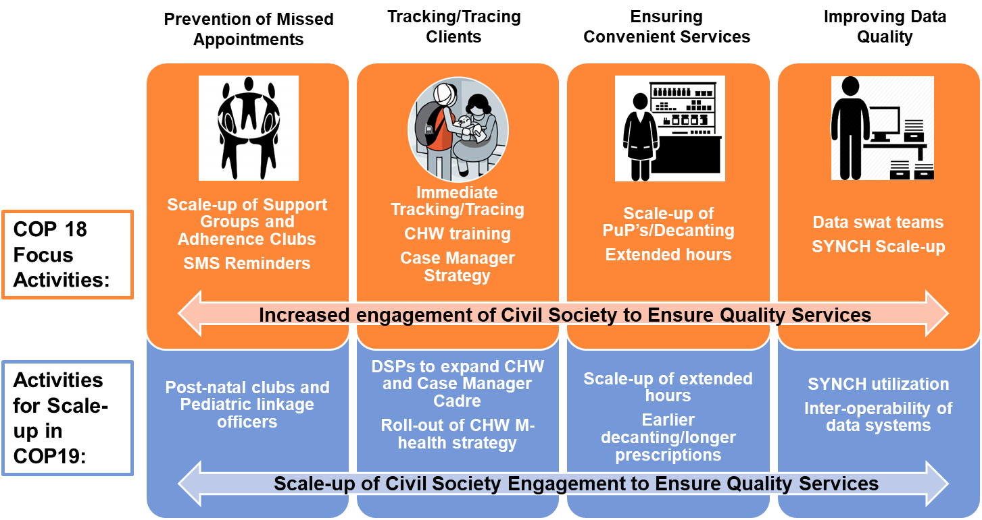
PEPFAR-SA Core Activities for Improving Retention in COP18 and COP19 are Shown Here

Slide 7

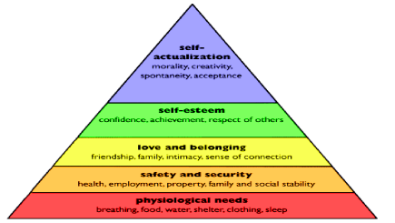


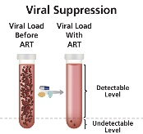
Case Management Strategy is Core to Preventing Missed Appointments
Ongoing HIV Counselling
Psychosocial Support
Adherence Support
Retention and VLS
Positive messaging (ART/quality of life)
U=U
Promote index testing
Importance of giving correct contact information
Disclosure Support
Perceived stigma
Mental health screening
Referral for Psychosocial support
Peer support groups
Client education & empowerment (HIV/ART/ VL)
Own wellness
Appointment reminders
Follow the tracing and tracking algorithm (24 hr call)
Motivation for VLS
Multi-month prescription 6m &
Decanting offsite at 12 months if VLS
Improve client/clinic communication (Travel/Relocation)

Slide 8
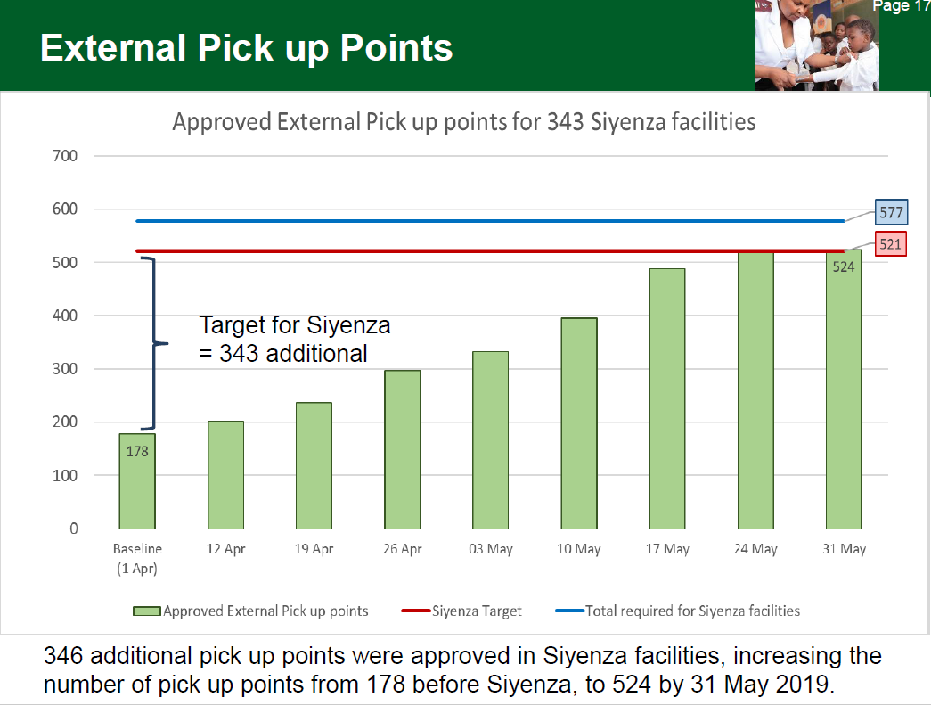
Scaling-up Decanting and Improving CCMDD Data through the Scale-up of SYNCH are Working to Improve both Patient-Friendly Services and Data Quality
Decanting coverage remains slightly lower than targeted at 55% of those with VL suppression
(COP18 target was 60%)
Collaboration with NDOH to rapidly expand decanting options through Siyenza/Operation Phuthuma yielding results, with increase in ePuP from 178 to 524 in just 2 months

Slide 9
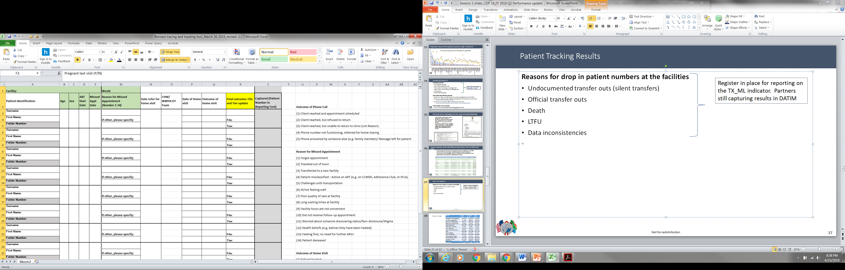
A Harmonized Register Including Final Outcome and Capturing of Outcome in Tier was Shared with All Partners to Improve Tracking/Tracing at the Site Level
Partners are able to adapt these as they see fit, but all partners should be recording outcomes of home visits and ultimate return to care in the register’s in use, not just outcome of tracking/tracing calls

Slide 10
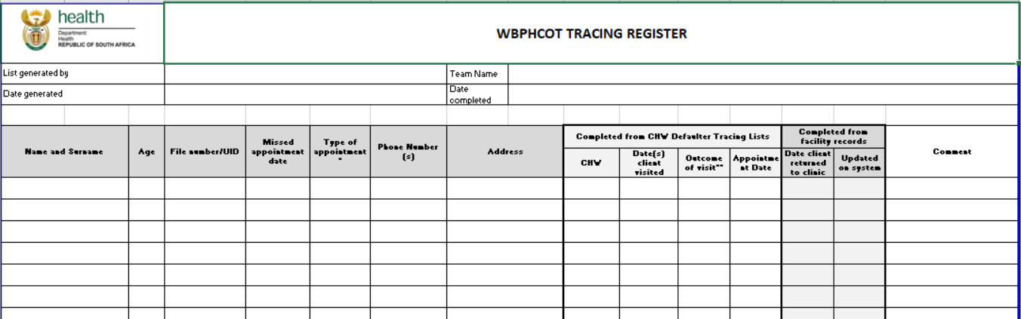
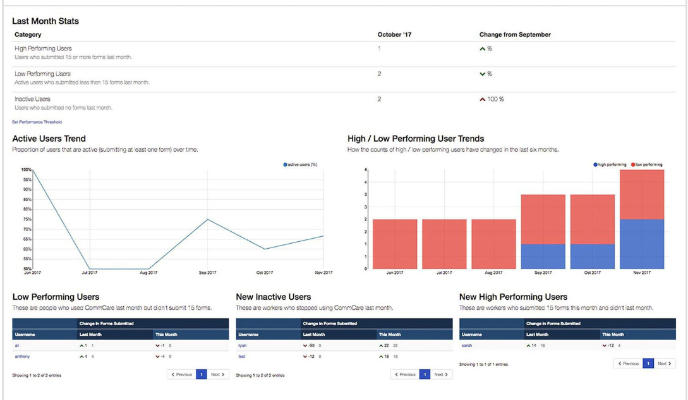
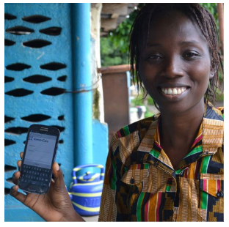
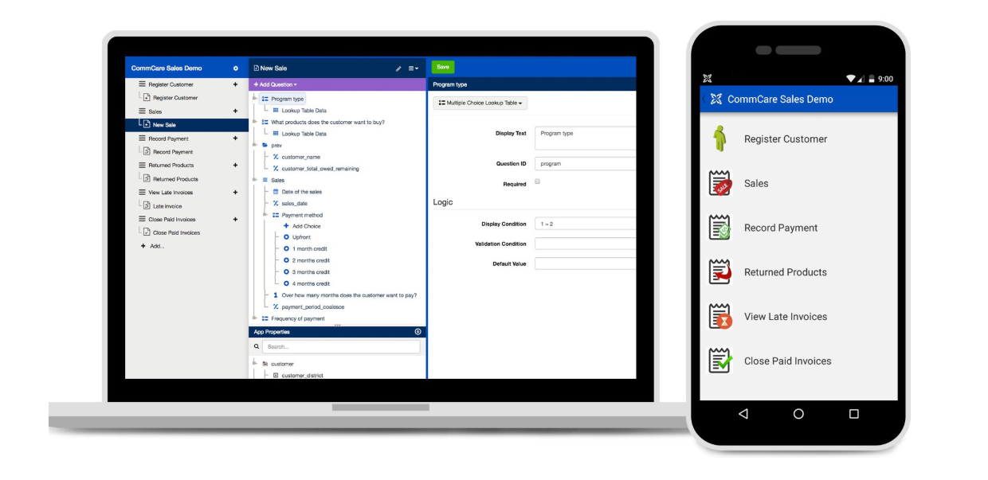
PEPFAR SA Team Simultaneously Working with NDOH to Automate this Process Using CommCare mHealth Solution to be Piloted Beginning Aug 2019
CommCare Mhealth Solution
Notes:
Paper tools – Revised NIDS indicators under final approval review-> being sent to NHISSA tomorrow
M&E paper tool pilot complete – tool revisions and SOP’s underway
DSP support for printing?, training, and rolling out from February

Slide 11
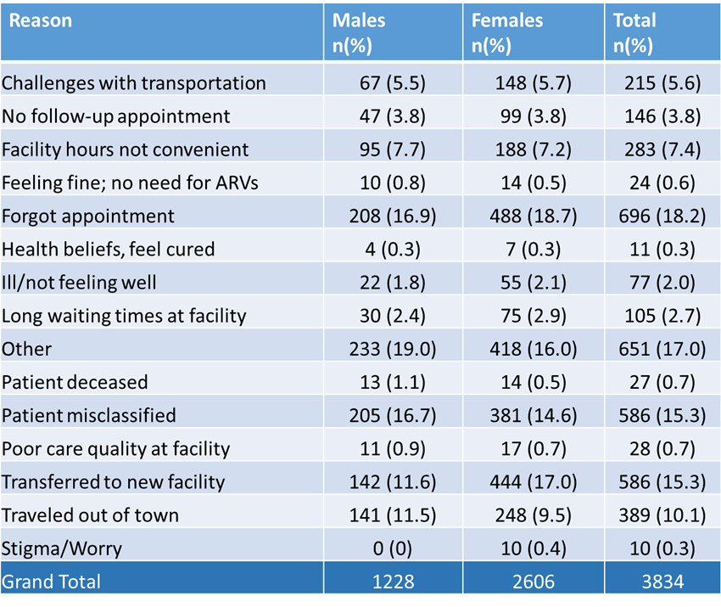
Initial System Set-Up to Capture Reasons for Missed Appointments Designed to Enable Site/Population Specific Solutions
Reasons for missing appointment
Individualized Solutions
Community ART
Extended Hours
Appointment Reminders
Data Quality Approached
Networked data systems
Pre-packs

Slide 12
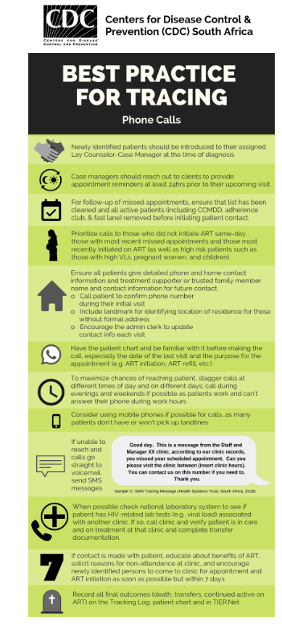
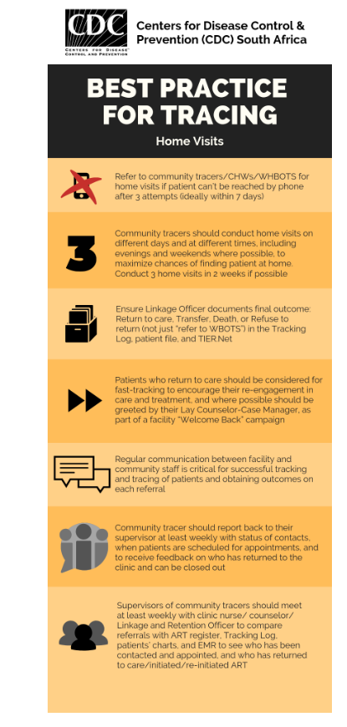
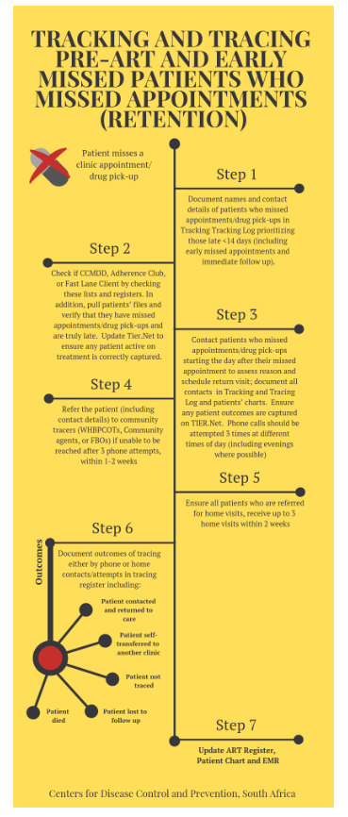
SOPs/Job AIDS Developed to Support Implementation of Tracking/Tracing Shared with DSPs and Site Leads

Slide 13
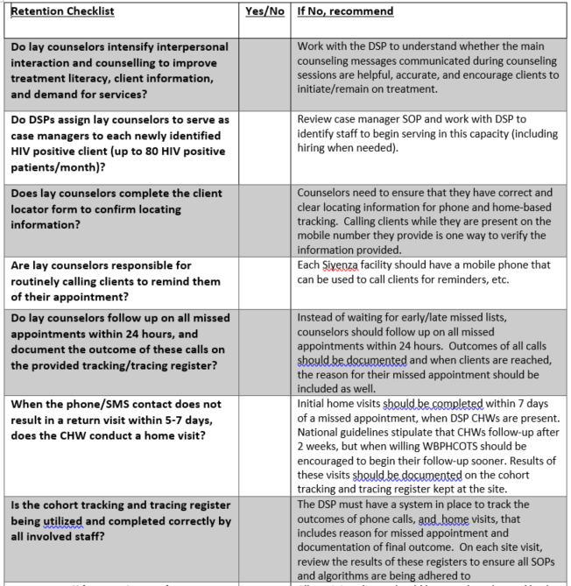
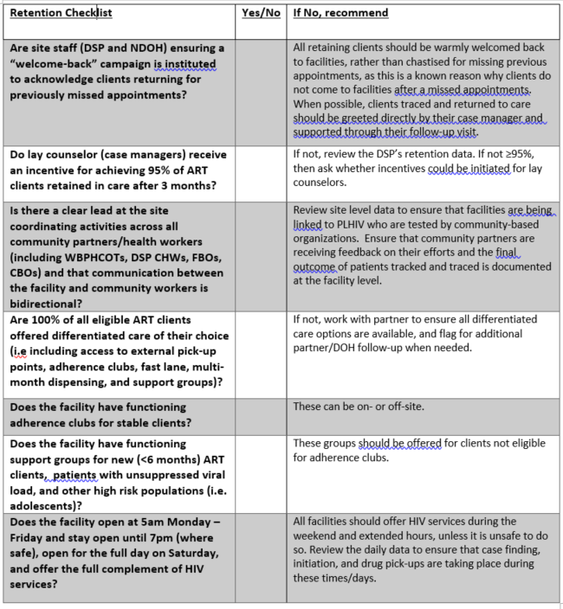
Siyenza Retention Developed to Orient Siyenza Staff to These Core Interventions

Slide 14
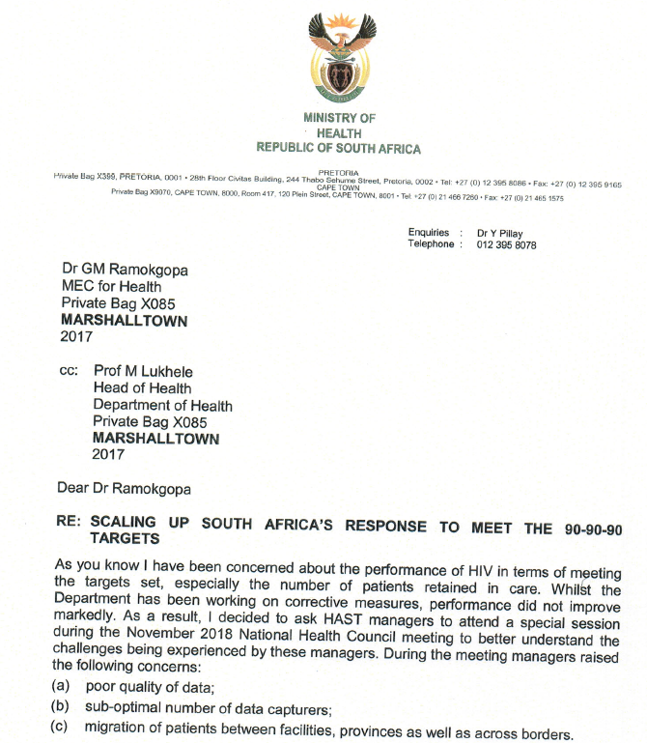
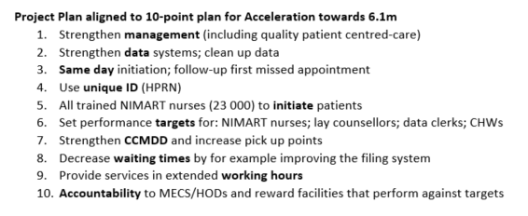
Many of Activities were also supported by the NDOH Circular/Operation Phuthuma

Slide 15
Next Steps/Way Forward
CDC-SA Office working to:
Review tools being utilized for potential improvements
Launch case manager task team to review implementation and further develop SOPs around implementation of this strategy
Institute analytic support for existing tools to better provide feedback to partners and site leads on data currently available
Continue to work nationally to develop/implement technologic approaches to improving the logisitics around some of these tasks (e.g. Tier updates; mHealth solutions)

Slide 16
Next Steps/Way Forward
Site Leads encouraged to:
Review existing tools/registers/data and discuss with the PO/AM for your partner and/or the C&T Branch if you have any questions about how these tools/activities should be implemented
Utilize the retention checklist to assess how these interventions are being implemented at the site you support and log any deficiencies in the tracker (feedback on this checklist again, can be provided to Siyenza/C&T Teams)
Review available data on missed appointments from your site and discuss with your site leads what specific approaches might be used to address this
Share best practices you find at your site with the Siyenza team
Avoid developing or implementing new tools without further discussion with Siyenza/C&T teams
Volunteer to provide technical support if a specific interest in further improving approach to retention in SA

Slide 17
Discussion

Slide 18
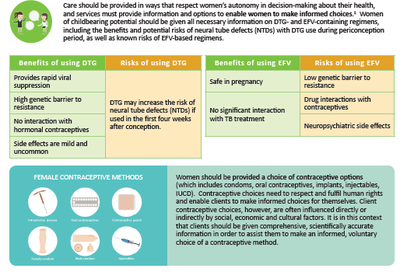
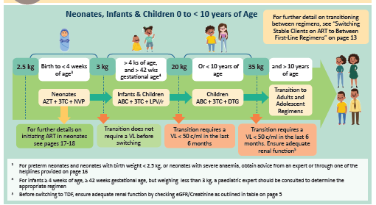
FYI - TLD Update
Abridged TLD Guidelines completed including:
Informed choice for women of reproductive potential
Plan to transition of almost all populations >20kg to DTG-based 1st line regimen
Elimination of NVP except in children <4wks and/or <3kg
Abridged guidelines and training materials shared with CDC (KnowledgeHub) and are now available for sharing
Master Training held July 9-11 and Provincial TOT’s are on-going
Provinces are now in the process of ordering supply with expectation to begin distribution in early September

